Slide 1
MODULE 1: Introduction to Wireless Communication Fundamentals and 5G Technology
M1 S2
Frequency Bands and Spectrum Allocation in 5G;

Slide 2
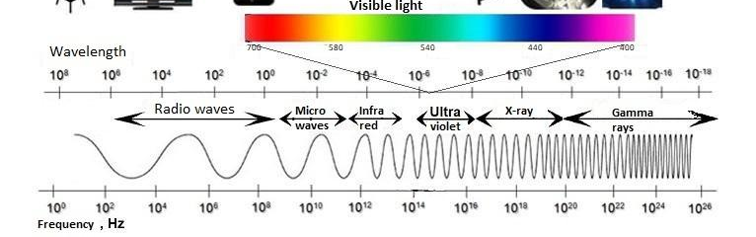
Frequency Bands and Spectrum Allocation in 5G
The electromagnetic spectrum is the set of all frequencies and the energy transmitted over electromagnetic waves is highly regulated based on frequency bands.
A frequency band can be described as a collection of frequencies ranging from a lower frequency to a higher frequency.

Slide 3
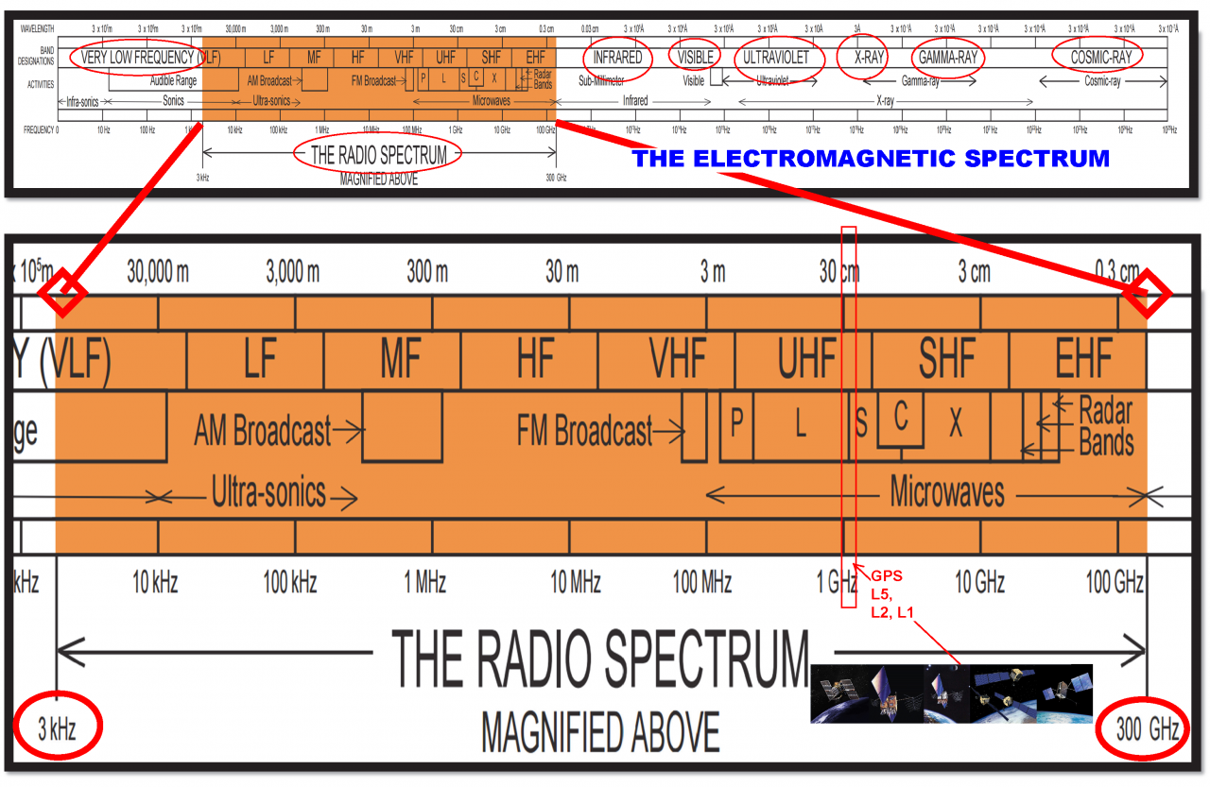
Frequency Bands and Spectrum Allocation in 5G
The radio spectrum is the part of the electromagnetic spectrum with frequencies from 3 Hz to 3,000 GHz.
Electromagnetic waves in this frequency range, called radio waves, are widely used in modern technology, particularly in telecommunication..

Slide 4
Activity-1
Using Internet Find the Regulated frequency spectrum

Slide 5
Frequency Bands and Spectrum Allocation in 5G
ITU divides the radio spectrum into 12 bands with the Spectrum Frequency and wavelength
Band Name | Abbrevation | ITU band Number | Frequency and wavelength
Extremely low frequency | ELF | 1 | 3–30 Hz 100,000–10,000 km
Super low frequency | SLF | 2 | 30–300 Hz 10,000–1,000 km
Ultra low frequency | ULF | 3 | 300–3,000 Hz 1,000–100 km
Very low frequency | VLF | 4 | 3–30 kHz 100–10 km
Low frequency | LF | 5 | 30–300 kHz 10–1 km
Medium frequency | MF | 6 | 300–3,000 kHz 1,000–100 m

Slide 6
Frequency Bands and Spectrum Allocation in 5G
Remaining are
Band Name | Abbrevation | ITU band Number | Frequency and wavelength
High frequency | HF | 7 | 3–30 MHz 100–10 m
Very high frequency | VHF | 8 | 30–300 MHz 10–1 m
Ultra high frequency | UHF | 9 | 300–3,000 MHz 100–10 cm
Super high frequency | SHF | 10 | 3–30 GHz 10–1 cm
Extremely high frequency | EHF | 11 | 30–300 GHz 10–1 mm
Terahertz or tremendously high frequency | THF | 12 | 300–3,000 GHz 1–0.1 mm

Slide 7
Frequency Bands and Spectrum Allocation in 5G
One widely used standard is the IEEE radar bands established by the US Institute of Electrical and Electronics Engineers.
Band designation | Frequency range | Explanation of meaning of letters
HF | 0.003 to 0.03 GHz | High frequency^{[15]}
VHF | 0.03 to 0.3 GHz | Very high frequency^{[15]}
UHF | 0.3 to 1 GHz | Ultra-high frequency^{[15]}
L | 1 to 2 GHz | Long wave
S | 2 to 4 GHz | Short wave
C | 4 to 8 GHz | Compromise between S and X
X | 8 to 12 GHz | Used in World War II for fire control, X for cross (as in crosshair). Exotic.^{[16]}
K_{u} | 12 to 18 GHz | Kurz-under
K | 18 to 27 GHz | German: Kurz (short)
K_{a} | 27 to 40 GHz | Kurz-above
V | 40 to 75 GHz
W | 75 to 110 GHz | W follows V in the alphabet^{[citation needed]}
mm or G | 110 to 300 GHz^{[note 1]} | Millimeter^{[14]}

Slide 8
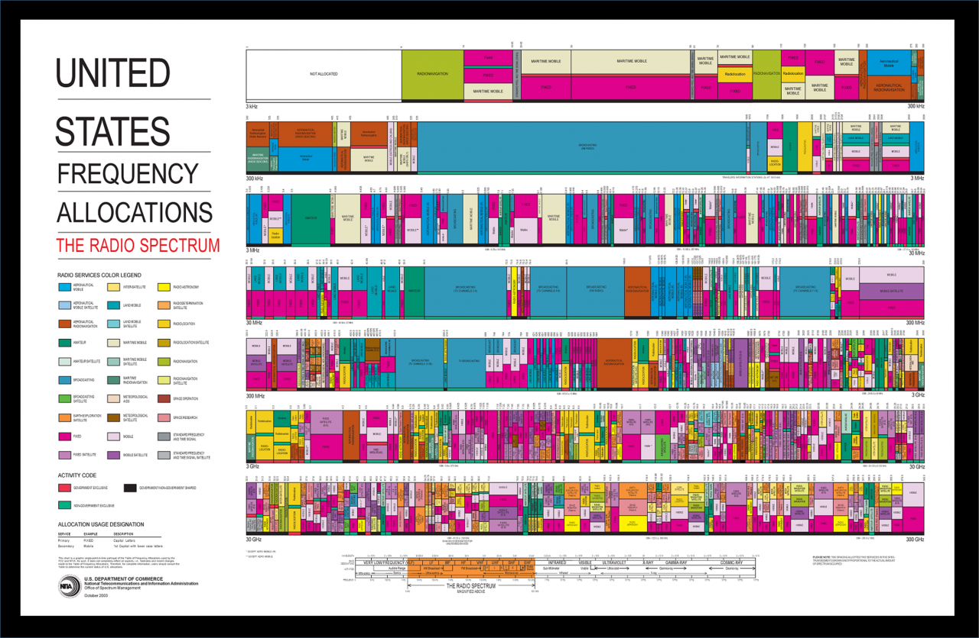
Frequency Bands and Spectrum Allocation in 5G

Slide 9
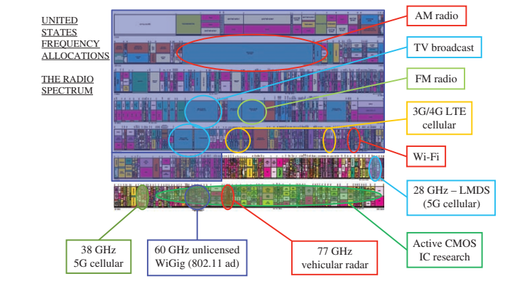
Frequency Bands and Spectrum Allocation in 5G

Slide 10
Frequency Bands and Spectrum Allocation in 5G
Today’s 3G and 4G cellular and WiFi carrier frequencies are mostly in between 300 MHz and 3000 MHz.
For 5G refer following table
Band | Duplex mode | ƒ (MHz) | Common name | Subset of band | Uplink (MHz) | Downlink (MHz) | Duplex spacing (MHz) | Channel bandwidths (MHz)
n1 | FDD | 2100 | IMT | n65 | 1920 – 1980 | 2110 – 2170 | 190 | 5, 10, 15, 20
n2 | FDD | 1900 | PCS | n25 | 1850 – 1910 | 1930 – 1990 | 80 | 5, 10, 15, 20
n3 | FDD | 1800 | DCS |  | 1710 – 1785 | 1805 – 1880 | 95 | 5, 10, 15, 20, 25, 30
n5 | FDD | 850 | CLR |  | 824 – 849 | 869 – 894 | 45 | 5, 10, 15, 20
n7 | FDD | 2600 | IMT‑E |  | 2500 – 2570 | 2620 – 2690 | 120 | 5, 10, 15, 20, 25, 30, 40, 50

Slide 11
Frequency Bands and Spectrum Allocation in 5G
Band | Duplex mode | ƒ (MHz) | Common name | Subset of band | Uplink (MHz) | Downlink (MHz) | Duplex spacing (MHz) | Channel bandwidths (MHz)
n8 | FDD | 900 | Extended GSM |  | 880 – 915 | 925 – 960 | 45 | 5, 10, 15, 20
n12 | FDD | 700 | Lower SMH |  | 699 – 716 | 729 – 746 | 30 | 5, 10, 15
n14 | FDD | 700 | Upper SMH |  | 788 – 798 | 758 – 768 | −30 | 5, 10
n18 | FDD | 850 | Lower 800 (Japan) |  | 815 – 830 | 860 – 875 | 45 | 5, 10, 15
n20 | FDD | 800 | Digital Dividend (EU) |  | 832 – 862 | 791 – 821 | −41 | 5, 10, 15, 20
For More refer: https://www.cablefree.net/wirelesstechnology/4glte/5g-frequency-bands-lte/

Slide 12
Frequency Bands and Spectrum Allocation in 5G (INDIA)
List of Supported 5G Bands in India
Low-band frequencies include 600 MHz, 700 MHz, 800 MHz, 900 MHz, 1800 MHz, 2100 MHz, 2300 MHz, and 2500 MHz.
Mid-band frequency is 3300 MHz.
High-band frequency of up to 26 GHz, known as mmWave. All telecom operators have acquired all kinds of frequency bands.

Slide 13
!!THANK YOU!! !! Have a Nice Day!!
Today we learned about
Frequency Bands and Spectrum Allocation in 5G

Slide 14
MODULE 1: Introduction to Wireless Communication Fundamentals and 5G Technology
M1 S3
Multiple Access Techniques: FDMA, TDMA, CDMA

Slide 15
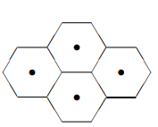
Multiple Access Techniques: FDMA, TDMA, CDMA
A cellular network consists of a number of fixed base stations, one for each cell.
The total coverage area is divided into cells and a mobile communicates with the base station(s) close to it.
At the physical and medium access layers, there are two main issues in cellular communication: multiple access and interference management.
The first issue addresses how the overall resource (time, frequency and space) of the system is shared by the users in the same cell (intra-cell) and
the second issue addresses the interference caused by simultaneous signal transmissions in different cells (inter-cell)

Slide 16
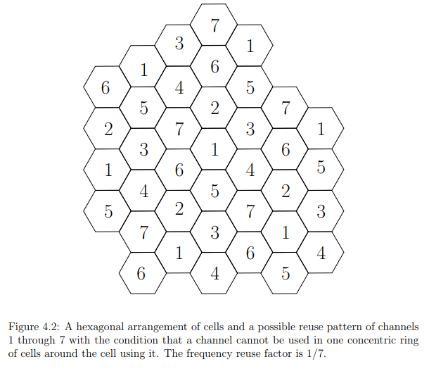
Multiple Access Techniques: FDMA, TDMA, CDMA The frequency reuse
At the physical and medium access layers, there are two main issues in cellular communication: multiple access and interference management.

Slide 17
Multiple Access Techniques: FDMA, TDMA, CDMA
In addition to resource sharing between different users, there is also an issue of how the resource is allocated between the uplink (the communication from the mobile users to the base station, also called the reverse link) and the downlink (the communication from the base station to the mobile users, also called the forward link).
There are two natural strategies for separating resources between the uplink and the downlink:
time division duplex (TDD) separates the transmissions in time and
frequency division duplex (FDD) achieves the separation in frequency.
Most commercial cellular systems are based on FDD.

Slide 18
Multiple Access Techniques: FDMA, TDMA, CDMA
Multiple access schemes are used to allow many mobile users to share simultaneously a finite amount of radio spectrum.
The sharing of spectrum is required to achieve high capacity by simultaneously allocating the available bandwidth (or the available amount of channels) to multiple users.
For high quality communications, this must be done without severe degradation in the performance of the system..

Slide 19
Multiple Access Techniques: FDMA, TDMA, CDMA
In wireless communications systems, it is often desirable to allow the subscriber to send simultaneously information to the base station while receiving information from the base station.
For example, in conventional telephone systems, it is possible to talk and listen simultaneously, and this effect, called duplexing, is generally required in wireless telephone systems...

Slide 20
Multiple Access Techniques: FDMA, TDMA, CDMA FDD
Duplexing may be done using frequency or time domain techniques.
Frequency division duplexing (FDD) provides two distinct bands of frequencies for every user.
The forward band provides traffic from the base station to the mobile, and the reverse band provides traffic from the mobile to the base station.
In FDD, any duplex channel actually consists of two simplex channels (a forward and reverse), and a device called a duplexer is used inside each subscriber unit and base station to allow simultaneous bidirectional radio transmission and reception for both the subscriber unit and the base station on the duplex channel pair.
The frequency separation between each forward and reverse channel is constant throughout the system, regardless of the particular channel being used....

Slide 21
Multiple Access Techniques: FDMA, TDMA, CDMA TDD
Time division duplexing (TDD) uses time instead of frequency to provide both a forward and reverse link.
In TDD, multiple users share a single radio channel by taking turns in the time domain.
Individual users are allowed to access the channel in assigned time slots, and each duplex channel has both a forward time slot and a reverse time slot to facilitate bidirectional communication.
If the time separation between the forward and reverse time slot is small, then the transmission and reception of data appears simultaneous to the users at both the subscriber unit and on the base station side.

Slide 22
Multiple Access Techniques: FDMA, TDMA, CDMA
Frequency division multiple access (FDMA), time division multiple access (TDMA), and code division multiple access (CDMA) are the three major access techniques used to share the available bandwidth in a wireless communication system.
These techniques can be grouped as narrowband and wideband systems, depending upon how the available bandwidth is allocated to the users..

Slide 23
Multiple Access Techniques: FDMA, TDMA, CDMA
Frequency division multiple access (FDMA), time division multiple access (TDMA), and code division multiple access (CDMA) are the three major access techniques used to share the available bandwidth in a wireless communication system.
These techniques can be grouped as narrowband and wideband systems, depending upon how the available bandwidth is allocated to the users..

Slide 24
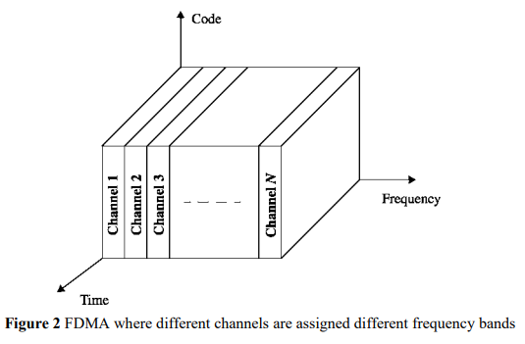
Multiple Access Techniques: FDMA, TDMA, CDMA
Frequency division multiple access (FDMA),
Frequency division multiple access (FDMA) assigns individual channels to individual users.
It can be seen from Figure that each user is allocated a unique frequency band or channel.
These channels are assigned on demand to users who request service.
During the period of the call, no other user can share the same channel.
In FDD systems, the users are assigned a channel as a pair of frequencies; one frequency is used for the forward channel, while the other frequency is used for the reverse channel.

Slide 25
Multiple Access Techniques: FDMA, TDMA, CDMA
Frequency division multiple access (FDMA),
The features of FDMA are as follows:
The FDMA channel carries only one phone circuit at a time.
If an FDMA channel is not in use, then it sits idle and cannot be used by other users to increase or share capacity. It is essentially a wasted resource.
After the assignment of a voice channel, the base station and the mobile transmit simultaneously and continously

Slide 26
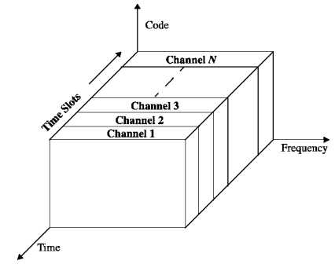
Multiple Access Techniques: FDMA, TDMA, CDMA
Time division multiple access (TDMA)
Time division multiple access (TDMA) systems divide the radio spectrum into time slots, and in each slot only one user is allowed to either transmit or receive.
It can be seen from Figure that each user occupies a cyclically repeating time slot, so a channel may be thought of as a particular time slot that reoccurs every frame, where N time slots comprise a frame.
TDMA systems transmit data in a buffer-and-burst method, thus the transmission for any user is non-continuous.
This implies that, unlike in FDMA systems which accommodate analog FM, digital data and digital modulation must be used with TDMA..

Slide 27
Multiple Access Techniques: FDMA, TDMA, CDMA
Time division multiple access (TDMA)
The transmission from various users is interlaced into a repeating frame structure as shown in Figure.
It can be seen that a frame consists of a number of slots.
Each frame is made up of a preamble, an information message, and tail bits.
In TDMA/ TDD, half of the time slots in the frame information message would be used for the forward link channels and half would be used for reverse link channels.
In TDMA/FDD systems, an identical or similar frame structure would be used solely for either forward or reverse transmission, but the carrier frequencies would be different for the forward and reverse links.

Slide 28
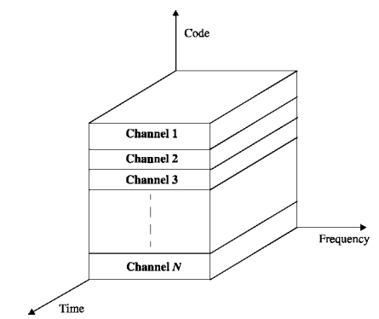
Multiple Access Techniques: FDMA, TDMA, CDMA
In code division multiple access (CDMA) systems,
In code division multiple access (CDMA) systems, the narrowband message signal is multiplied by a very large bandwidth signal called the spreading signal.
The spreading signal is a pseudonoise code sequence that has a chip rate which is orders of magnitudes greater than the data rate of the message.
All users in a CDMA system, as seen from Figure, use the same carrier frequency and may transmit simultaneously.
Each user has its own pseudorandom code word which is approximately orthogonal to all other codewords.

Slide 29
Multiple Access Techniques: FDMA, TDMA, CDMA
In code division multiple access (CDMA) systems,
The receiver performs a time correlation operation to detect only the specific desired codeword.
All other code words appear as noise due to de-correlation.
For detection of the message signal, the receiver needs to know the codeword used by the transmitter.
Each user operates independently with no knowledge of the other users...

Slide 30
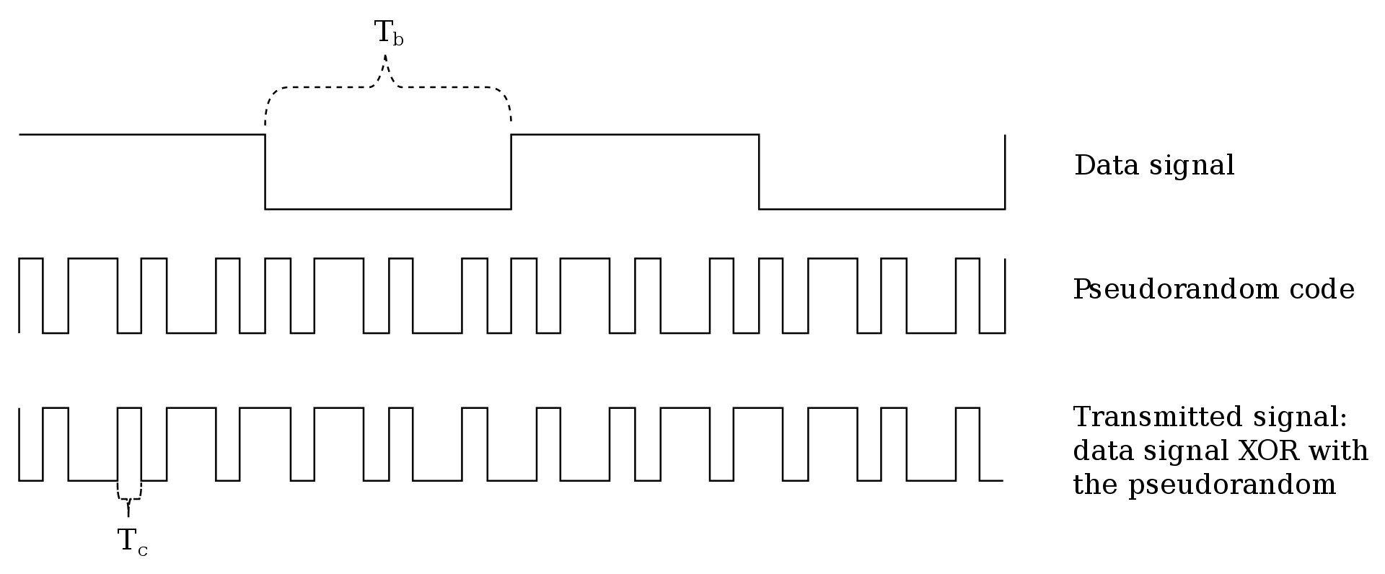
Multiple Access Techniques: FDMA, TDMA, CDMA
In code division multiple access (CDMA) systems,...

Slide 31
!!THANK YOU!! !! Have a Nice Day!!
Today we learned about
Multiple Access Techniques: FDMA, TDMA, CDMA

